Slide 1
M3-Microservice
Second iteration

Slide 2
To do
Document about Spring;
Design the overall architecture;
Establish application logic;
Create documentation for the REST API;

Slide 3
Done
Document about Spring ✓
  Katas
  Learn more by trying out new examples
Design the overall architecture✓
  Design the Spring Rest Repositories architecture allowing modular extension
  Decide which database to use ⬄ MongoDB
  Back-end of the MVC model
  Discuss with M4 for more implementation details

Slide 4
Done
Establish application logic✓
  2 controllers: one for users and one for locations
    UserController
    LocationController
Create documentation for the REST API✓
  Swagger

Slide 5
Work in progress
Collaboration with M4 for front-end development;
Locations Controller in Spring;
Users Controller in Spring;
Using Spring Security for sensitive data;
Document the REST API using Swagger;

Slide 6
Motivation for THE current progress
Collaboration with M4 module needs to be maintained to ensure a good design and no bugs;
Location/Users controller needs to be developed along the iterations to provide a complex and fully functional application;

Slide 7
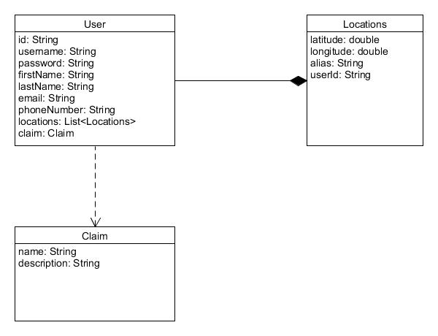
Domain Model

